Slide 1






Software Engineering (3rd ed.), By K.K Aggarwal & Yogesh Singh, Copyright © New Age International Publishers, 2007
1

Slide 2
Software Testing
What is Testing?
Many people understand many definitions of testing :
Testing is the process of demonstrating that errors are not present.
The purpose of testing is to show that a program performs its intended functions correctly.
Testing is the process of establishing confidence that a program does
what it is supposed to do.
These definitions are incorrect.
2

Slide 3
Software Testing
A more appropriate definition is:
“Testing is the process of executing a program with the intent of finding errors.”
3

Slide 4
Software Testing
Why should We Test ?
Although software testing is itself an expensive activity, yet launching of software without testing may lead to cost potentially much higher than that of testing, specially in systems where human safety is involved.
In the software life cycle the earlier the errors are discovered and removed, the lower is the cost of their removal.
4

Slide 5
Software Testing
Who should Do the Testing ?
Testing requires the developers to find errors from their software.
It is difficult for software developer to point out errors from own
creations.
Many organisations have made a distinction between development and testing phase by making different people responsible for each phase.
5

Slide 6
Software Testing
What should We Test ?
We should test the program’s responses to every possible input. It means, we should test for all valid and invalid inputs. Suppose a program requires two 8 bit integers as inputs. Total possible combinations are 2⁸x2⁸. If only one second it required to execute one set of inputs, it may take 18 hours to test all combinations. Practically, inputs are more than two and size is also more than 8 bits. We have also not considered invalid inputs where so many combinations are possible. Hence, complete testing is just not possible, although, we may wish to do so.
6

Slide 7
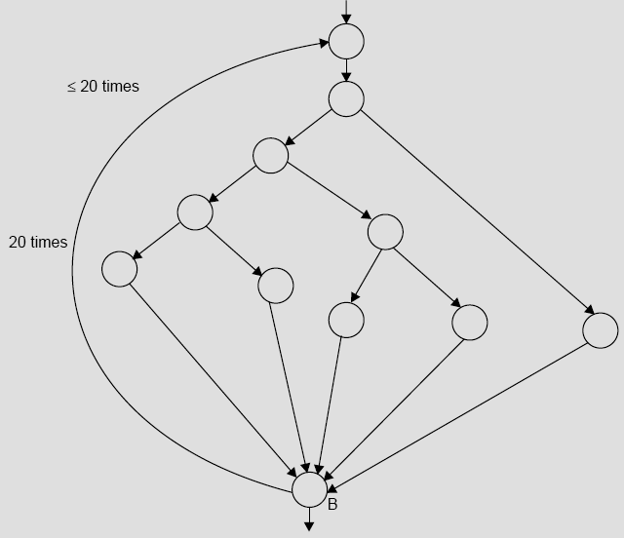
Software Testing
Fig. 1: Control flow graph
7

Slide 8
Software Testing
The number of paths in the example of Fig. 1 are 10¹⁴ or 100 trillions. It is computed from 5²⁰ + 5¹⁹ + 5¹⁸ + …… + 5¹; where 5 is the number of paths through the loop body. If only 5 minutes are required to test one test path, it may take approximately one billion years to execute every path.
8

Slide 9
Software Testing
Some Terminologies
) Error, Mistake, Bug, Fault and Failure
People make errors. A good synonym is mistake. This may be a syntax error or misunderstanding of specifications. Sometimes, there are logical errors.
When developers make mistakes while coding, we call these mistakes “bugs”.
A fault is the representation of an error, where representation is the mode of expression, such as narrative text, data flow diagrams, ER diagrams, source code etc. Defect is a good synonym for fault.
A failure occurs when a fault executes. A particular fault may cause different failures, depending on how it has been exercised.
9

